Slide 1
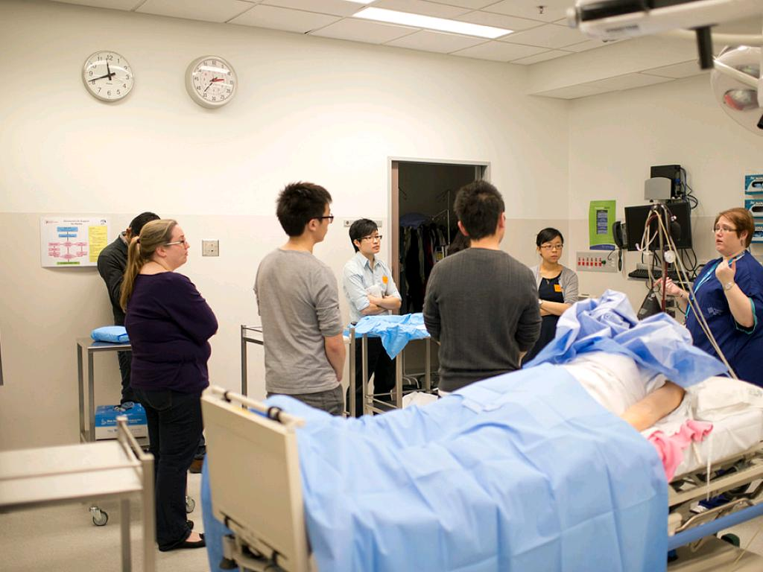
Bedside Teaching
cc: Monash University - https://www.flickr.com/photos/50357943@N08

Slide 2
Learning Objectives
By the end of the session, you should be able to:
Define the elements of the BEDSIDE approach to bedside teaching.
Practice teaching at the bedside and personalize the BEDSIDE approach by participating in a simulation exercise.
Employ effective bedside teaching techniques.

Slide 3

After participating in this session,residents will be able to conduct a teaching session at the bedside.
cc: Foomandoonian - https://www.flickr.com/photos/38677669@N00

Slide 4

The “BEDSIDE” Approach to Bedside Teaching
Briefing
Expectations
Demonstration
Specific feedback
Inclusion of micro skills
Debriefing
Education
cc: Antonio TwizShiz Edward - https://www.flickr.com/photos/16082542@N00

Slide 5
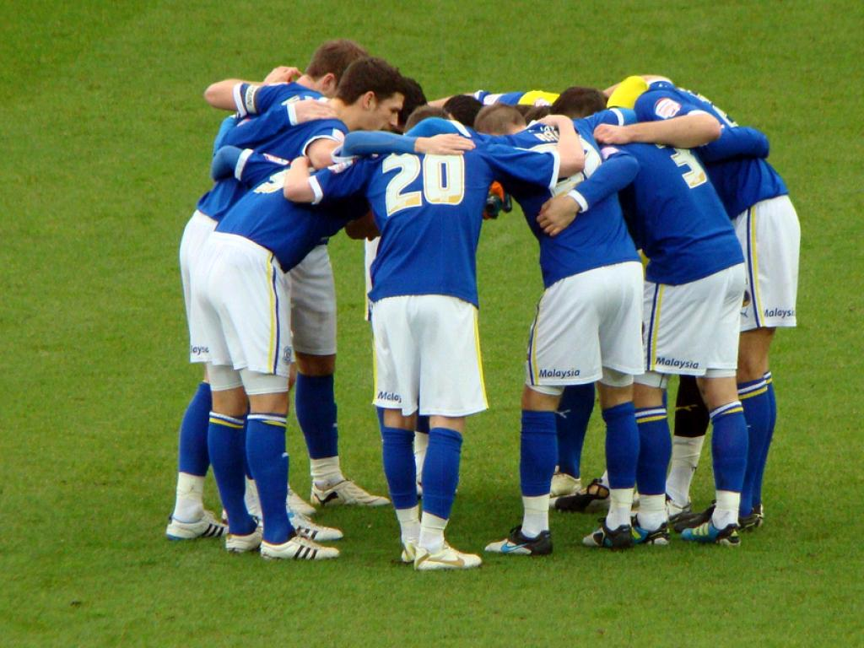
BRIEFING
Prepare the learner(s) before meeting with the patient:
Prepare the patient, explain roles.
cc: joncandy - https://www.flickr.com/photos/37195744@N03

Slide 6

EXPECTATIONS
What are the learner’s learning goals? Your goals for learner?
Why learn this particular topic today?
cc: Jeff Kubina - https://www.flickr.com/photos/95118988@N00

Slide 7

DEMONSTRATION
cc: Alex E. Proimos - https://www.flickr.com/photos/34120957@N04

Slide 8

SPECIFIC AND LEARNER CENTERED
cc: giulia.forsythe - https://www.flickr.com/photos/59217476@N00

Slide 9

INCLUSION OF MICROSKILLS
1. Get a commitment
2. Probe for supporting evidence
3. Teach general rules
4. Reinforce what was done right
5. Correct mistakes
cc: Capt Kodak - https://www.flickr.com/photos/35114754@N00

Slide 10

DEBRIEFING
cc: MDGovpics - https://www.flickr.com/photos/64018555@N03

Slide 11

EDUCATION
Readings
Computer resources
Consultants
Other resources
cc: RichGrundy - https://www.flickr.com/photos/32888907@N03

Slide 12

LEVELS OF UNDERSTANDING
cc: koalazymonkey - https://www.flickr.com/photos/9544998@N04

