Slide 1
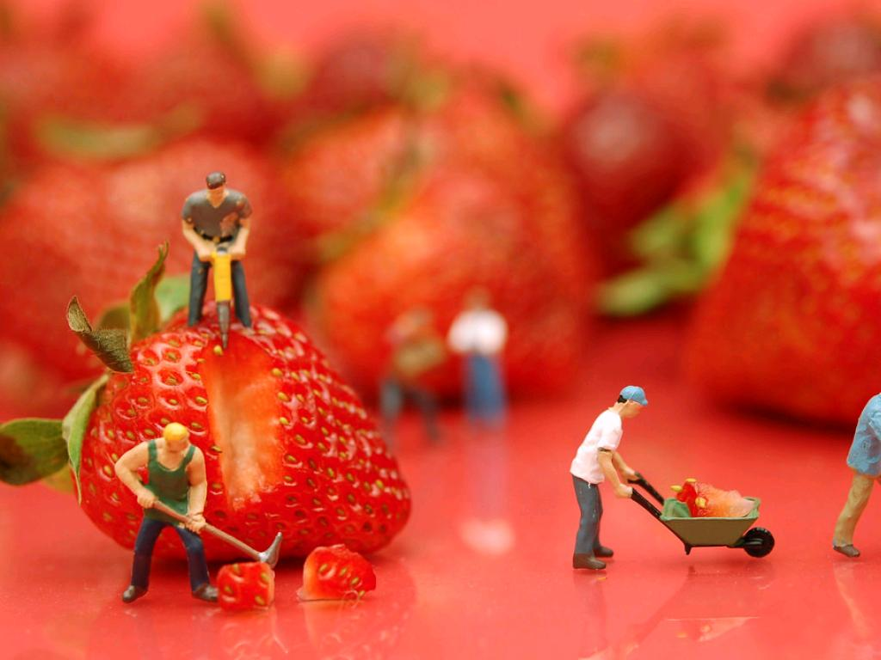
WORK ROUNDS
cc: JD Hancock - https://www.flickr.com/photos/83346641@N00

Slide 2
Learning Objectives
By the end of this session, you will be able to:
Define the elements of the “LMNOPQRST” approach to work rounds/small group teaching
Practice work rounds and personalize the “LMNOPQRST” approach by participating in a simulation exercise.
Employ effective small group teaching techniques

Slide 3
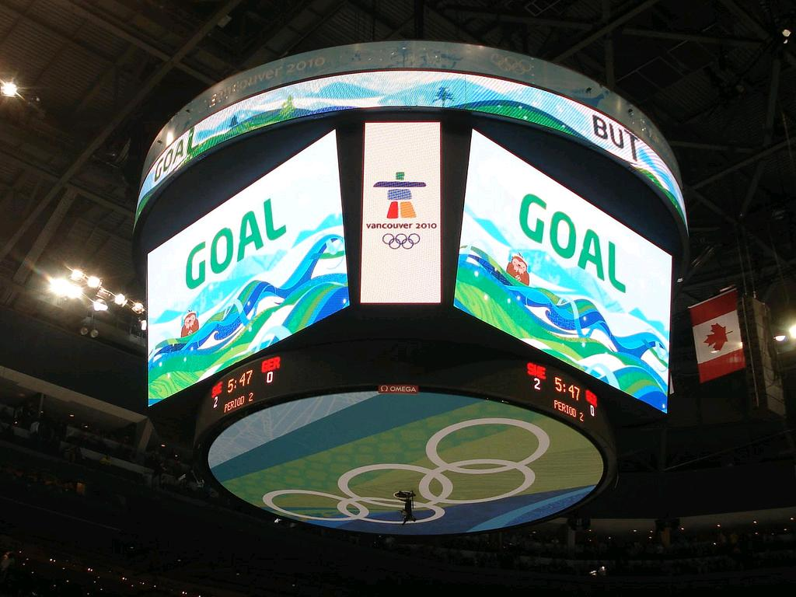
Residents will be able to lead inpatient work rounds, incorporating teaching appropriate to each learner’s level of training.
cc: mag3737 - https://www.flickr.com/photos/50318388@N00

Slide 4

Small group teaching
cc: woodleywonderworks - https://www.flickr.com/photos/73645804@N00
Notes:
Challenges of small-group teaching:
Teacher must facilitate learning for multiple learners at once.
These learners may be from different training levels or from different disciplines.
The senior resident can take the lead even if the attending physician is present.

Slide 5
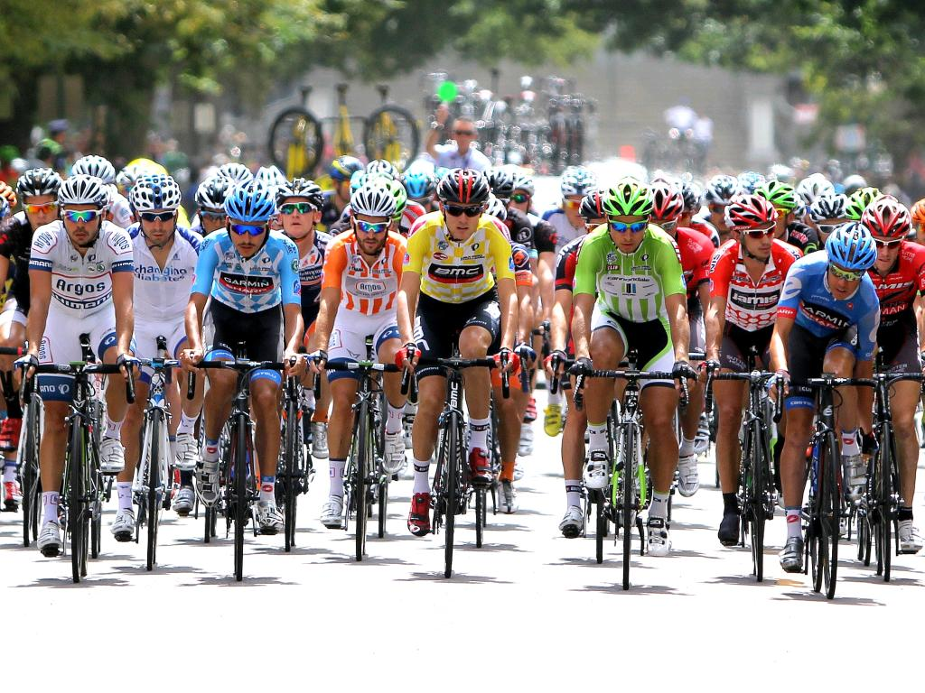
Challenges of small group teaching
cc: reid.neureiter - https://www.flickr.com/photos/21085902@N08
Notes:
Challenges of small-group teaching:
Teacher must facilitate learning for multiple learners at once.
These learners may be from different training levels or from different disciplines.
The senior resident can take the lead even if the attending physician is present.

Slide 6

The “LMNOPQRST” Approach
cc: Bernal Saborio G. (berkuspic) - https://www.flickr.com/photos/44073224@N04

Slide 7

“LMNOPQRST”
Learners
Microskills
Needs
Organization
Presentation
Questions(Recall, Synthesis)
Teaching
cc: mrsdkrebs - https://www.flickr.com/photos/56041749@N02

Slide 8
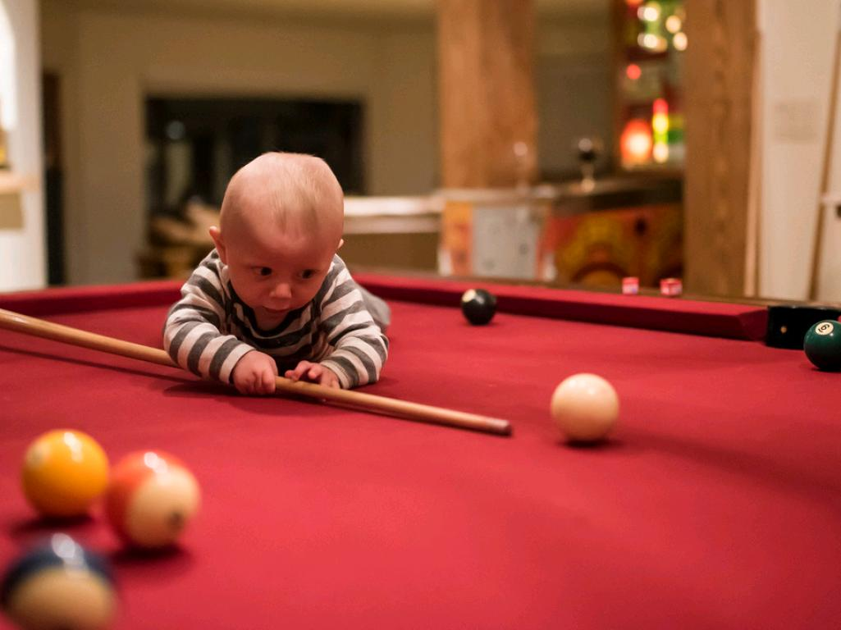
LEARNERS
cc: BPPrice - https://www.flickr.com/photos/73082817@N03
Notes:
Who are all your learners for this
small-group discussion?
Help create a positive learning
climate by ensuring that everyone
in the group knows each member’s
name, discipline and training level.

Slide 9

MICROSKILLS
cc: Duncan Rawlinson - Duncan.co - @thelastminute - https://www.flickr.com/photos/44124400268@N01
Notes:
Teach through questioning.
The “five microskills” model works in group teaching as well as in one-to-one precepting.
Make sure each team member participates in the discussion.

Slide 10

NEEDS
cc: eschipul - https://www.flickr.com/photos/16638697@N00
Notes:
Briefly establish learning goals for rounds, starting with the learners.
Is there anything they especially want to learn today?
What are your goals for them?

Slide 11
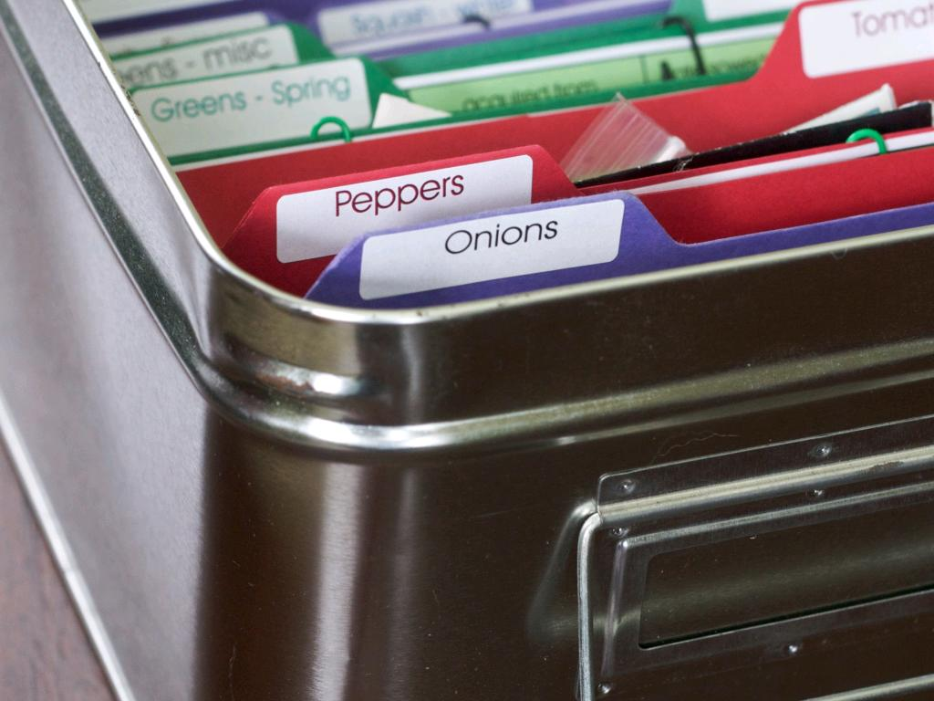
ORGANIZATION
cc: Chiot's Run - https://www.flickr.com/photos/34912142@N03
Notes:
How can you best organize rounds during the time you have?
Take into account:
The number of patients to present
Other scheduling factors (clinics, etc.)
Learning needs of the team
“Teachable moments”

Slide 12

PRESENTATION
cc: bengrey - https://www.flickr.com/photos/28196992@N07
Notes:
When learners present, have team listen without interruption.
Set guidelines for presentations:
Level of detail for new patients
Ongoing patients: one-sentence case summary, overnight progress, problem list review with today’s plans

Slide 13

QUESTIONS
cc: BAMCorp - https://www.flickr.com/photos/60766987@N00
Notes:
Use the five “microskills” to
maximize teachable moments:
1.Get a commitment
2.Probe for supporting evidence
3.Teach general rules
4.Reinforce what was done right
5.Correct mistakes

Slide 14

RECALL
cc: Kate~2112 - https://www.flickr.com/photos/50196384@N05
Notes:
Lower-order questions test learners’ recall of factual information.
Example: “What is Murphy’s sign?”

Slide 15

SYNTHESIS
cc: Nick in exsilio - https://www.flickr.com/photos/33563858@N00
Notes:
Higher-order questions test learners’ ability to synthesize and analyze information.
Example: “Given these physical findings, how would we now alter our differential diagnosis?”
Try to incorporate these “thinking questions” into the discussion.

Slide 16
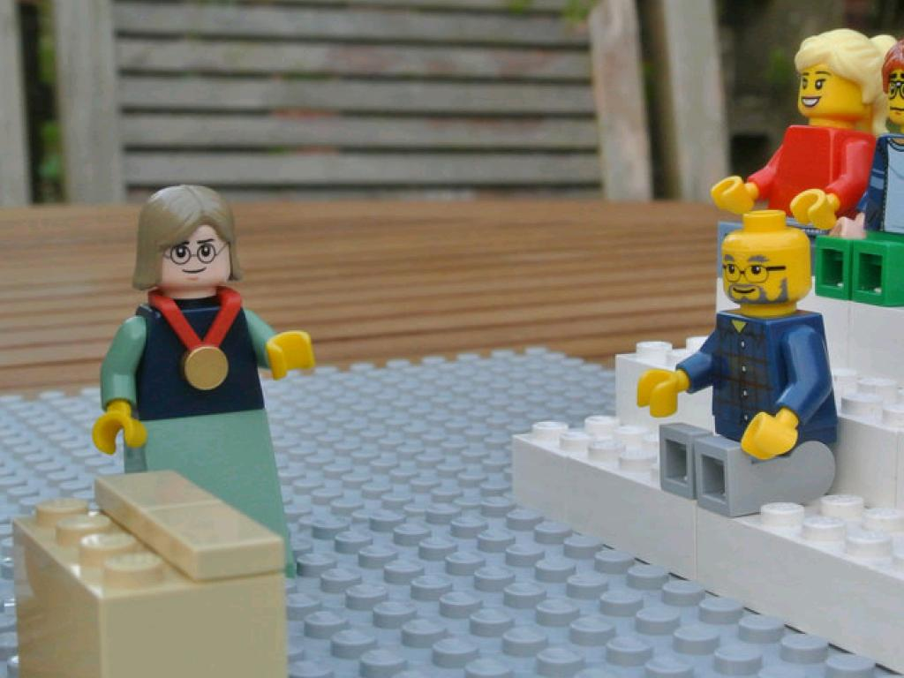
TEACHING
cc: followthethings.com - https://www.flickr.com/photos/64914918@N03
Notes:
Discuss resources for the team’s further learning:
Articles (which you can even bring in)
Online resources
Texts
Tailor your recommendations to learners’ individual training.

