Slide 1
Giving Lectures
Bringing Education & Service Together (BEST)

Slide 2
Learning Objectives
Deliver interactive mini-lectures
Explain the LECTURE approach
Employ effective lecture techniques

Slide 3
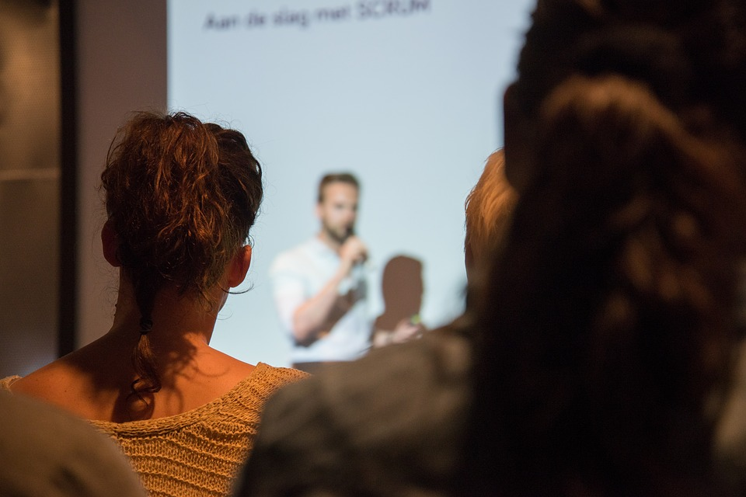
Lectures
Notes:
Lecturing is a familiar method of clinical teaching—and a difficult one to use well.
Throughout their careers, physicians may be asked to give lectures for learners, colleagues, patients, or others.

Slide 4
Challenges
Notes:
Challenges of lecturing:
The challenge of lecturing is to make it interactive enough that participants will learn from it.
For resident teachers, lectures may range from brief talks (1-2 learners) to longer lectures (e.g., grand rounds).

Slide 5
LECTURE Approach
Learning Outcomes
Evaluation
Control of session
Talk
Understanding
Retention
Education

Slide 6
Learning Outcomes
Notes:
In any teaching session, it’s important to clarify learning outcomes.
For lectures, teachers explain outcomes in the form of measurable, observable behaviors: the specific behaviors we expect attendees to be able to do after participating in the session.

Slide 7
By the end of this session, students will be able to describe one treatment strategy for acute low back strain.
Notes:
Example: “After participating in this session, students will be able to describe one treatment strategy for acute low back strain.”
Clarify why the audience needs to hear about this topic.

Slide 8
Evaluation
Notes:
Teach through questioning: early in the session, evaluate attendees’ prior experience and knowledge.
What are the attendees’ own learning goals for this session?
Give permission to reveal limitations and learning needs.

Slide 9
Control
Notes:
Control of Session
As the teacher and leader, you control the teaching session.
How can you best organize it to achieve your learning objectives?
Before the talk, spend some time organizing your materials.
Well-designed audiovisual materials can enhance learning:
Projected images
Handouts
Writing on board
Pace your talk: you don’t need to “cover” all material.

Slide 10
Talk
Notes:
Certain techniques will enhance your presentation:

Slide 11
Make Personal
Notes:
Make your talk personal
Include references to your own experiences.
Share relevant stories from your past.

Slide 12
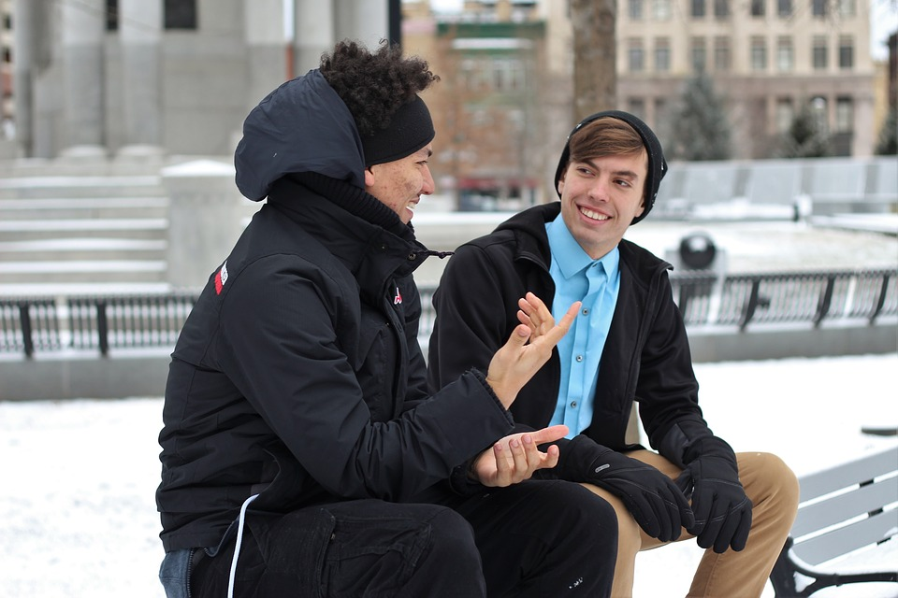
Conversational
Notes:
Use a conversational speaking style.
Talk with your audience, not at your audience.
Speak as if you were in an important discussion with a room full of friends.

Slide 13
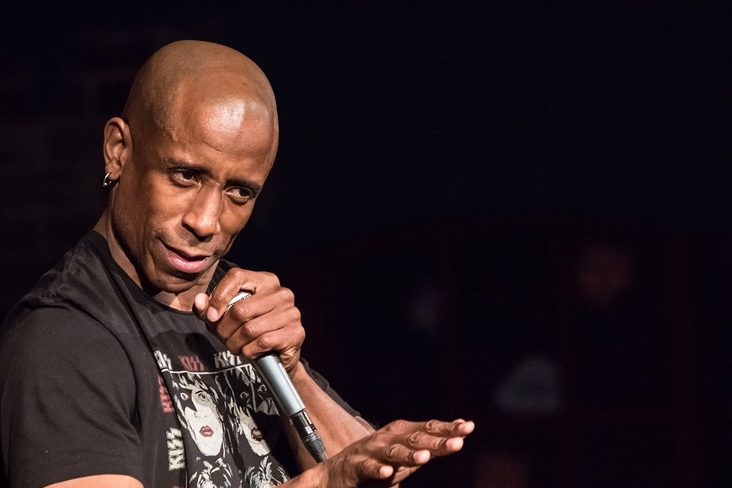
Natural
Notes:
Move and gesture naturally
Try to maintain an open and friendly body position

Slide 14
Don’t apologize!
Notes:
Never apologize for your presentation or any mistakes you may make during your presentation.
If you have given your best effort, you have nothing to apologize for.
If you apologize for things like nervousness, the apology only serves to emphasize your nerves and puts your audience on notice.
Apologizing for things like being under-prepared is actually an insult to your audience. If you didn’t respect them enough to properly prepare, don’t say that to their face!

Slide 15
Eye contact
Notes:
Look at your audience, not your slides or the board
Turning your back on someone you are speaking with is rude.
Not only is turning away from your audience rude, but it gives the appearance that you don’t know your topic well enough to speak on it without constantly referring to your notes.
Try to be inclusive with your eye contact. Don’t stare at one or two people the entire time, but scan the audience and focus on a few different people each time.

Slide 16
Understanding
Notes:
Help attendees understand the topic by asking them to analyze and synthesize the material.

Slide 17
Retention
Notes:
Help attendees retain what they’ve learned by encouraging review of facts and concepts.
Stopping periodically to ask review questions not only aids retention, but it serves to keep your listeners better engaged with your talk.

Slide 18
Education
Notes:
Mention—at least briefly—learning resources that attendees can use after the session:
Articles • Online resources • Texts
Encourage self-directed learning: what would attendees like to do to enhance their own learning?

Slide 19
Tips
Notes:
Here are a few additional tips on giving presentations.

Slide 20
Actively engage
Notes:
Find ways to make your audience part of your presentation. Use games, questions, polls, or something as simple as asking them to raise their hands. Not only will this connect you to your audience more effectively, it will help reduce any speaker anxiety you might be experiencing.

Slide 21
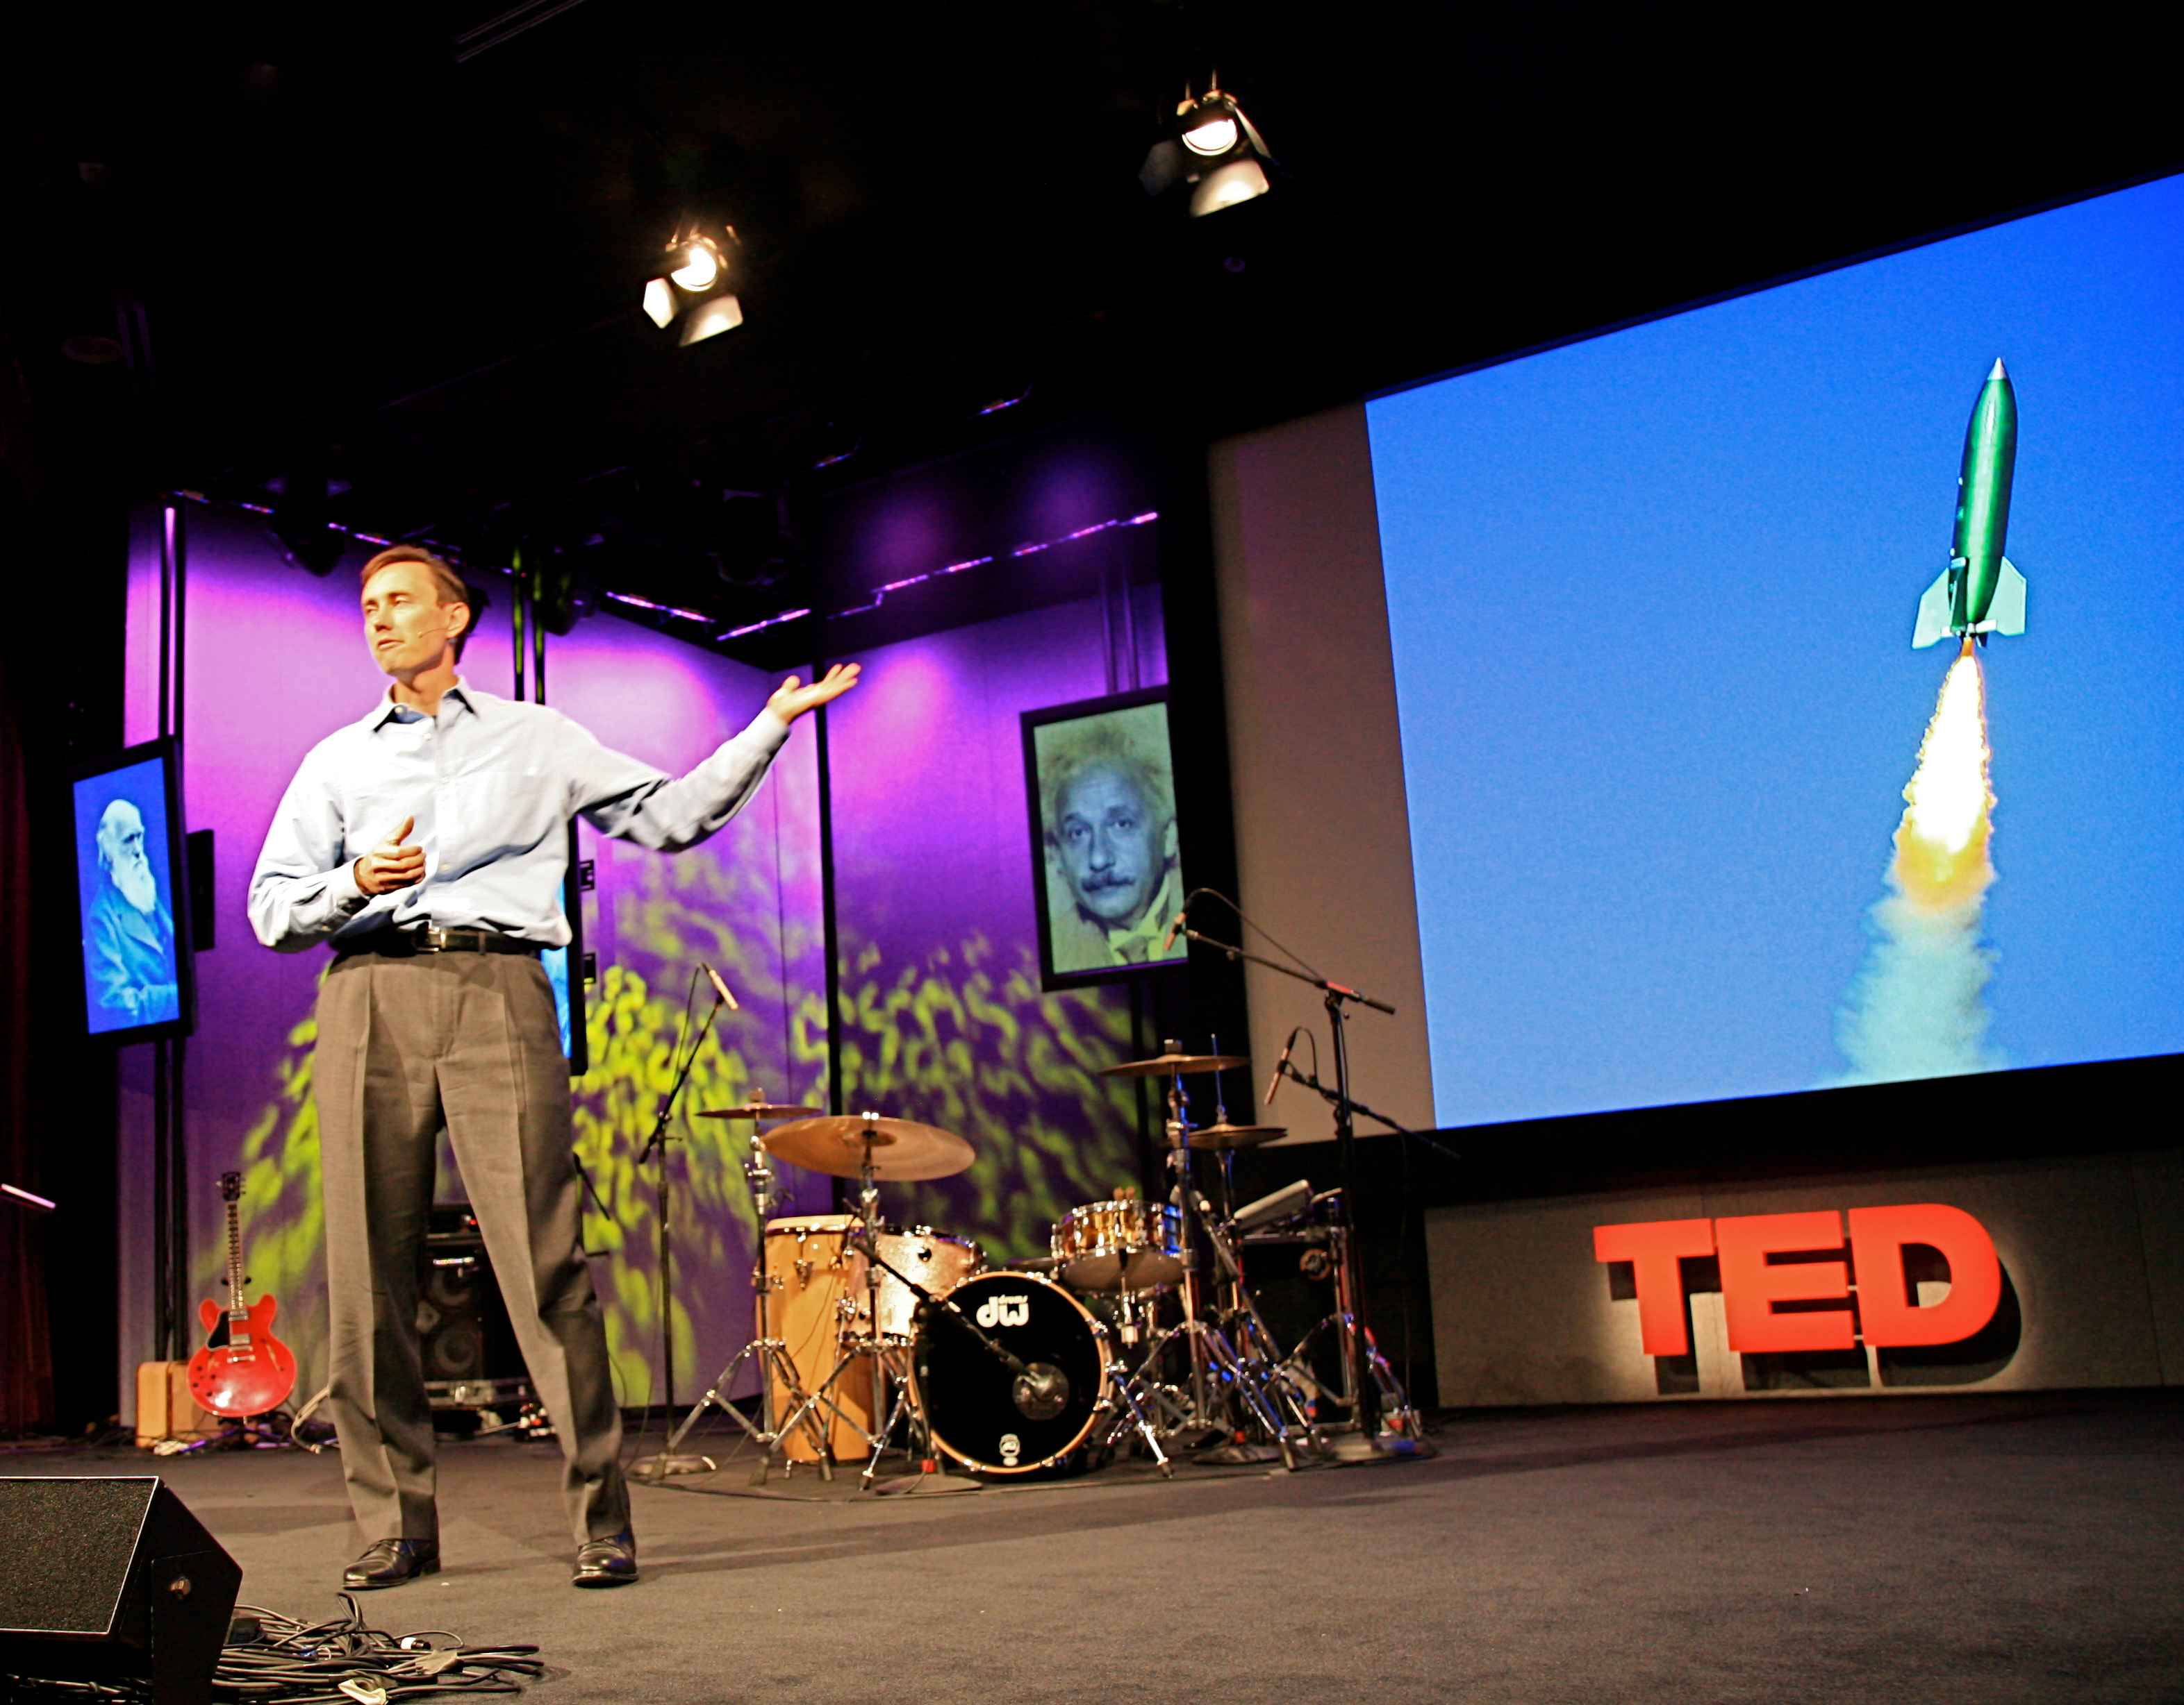
Visualize
Notes:
Using visual aids allows for multi-modal learning and increases listening. Assuming, of course, the visual aids are done well. Incorporating dynamic images encourages metaphorical thinking and aids student learning. Using humorous slides to make your point also engages the listeners emotions, which aids retention of the material. Staring at a lot of words or numbers on the screen is overwhelming for even the most sophisticated audience, even if that data reinforces key points of your presentation. Put any complicated data into easily-understandable visualizations. There are a number of excellent resources for creating infographics and other forms of data visualization.

Slide 22
Move
Notes:
Standing in the same spot communicates a lack of confidence and an unwillingness to connect with you audience. Move into the audience space as much as possible. Don’t lock yourself in place by standing directly next to your computer or behind a podium during your presentation. Use a clicker or wireless mouse to advance your slides to free yourself from your computer. If you are using a mic, try using a body mic that allows you to move about the space.

Slide 23
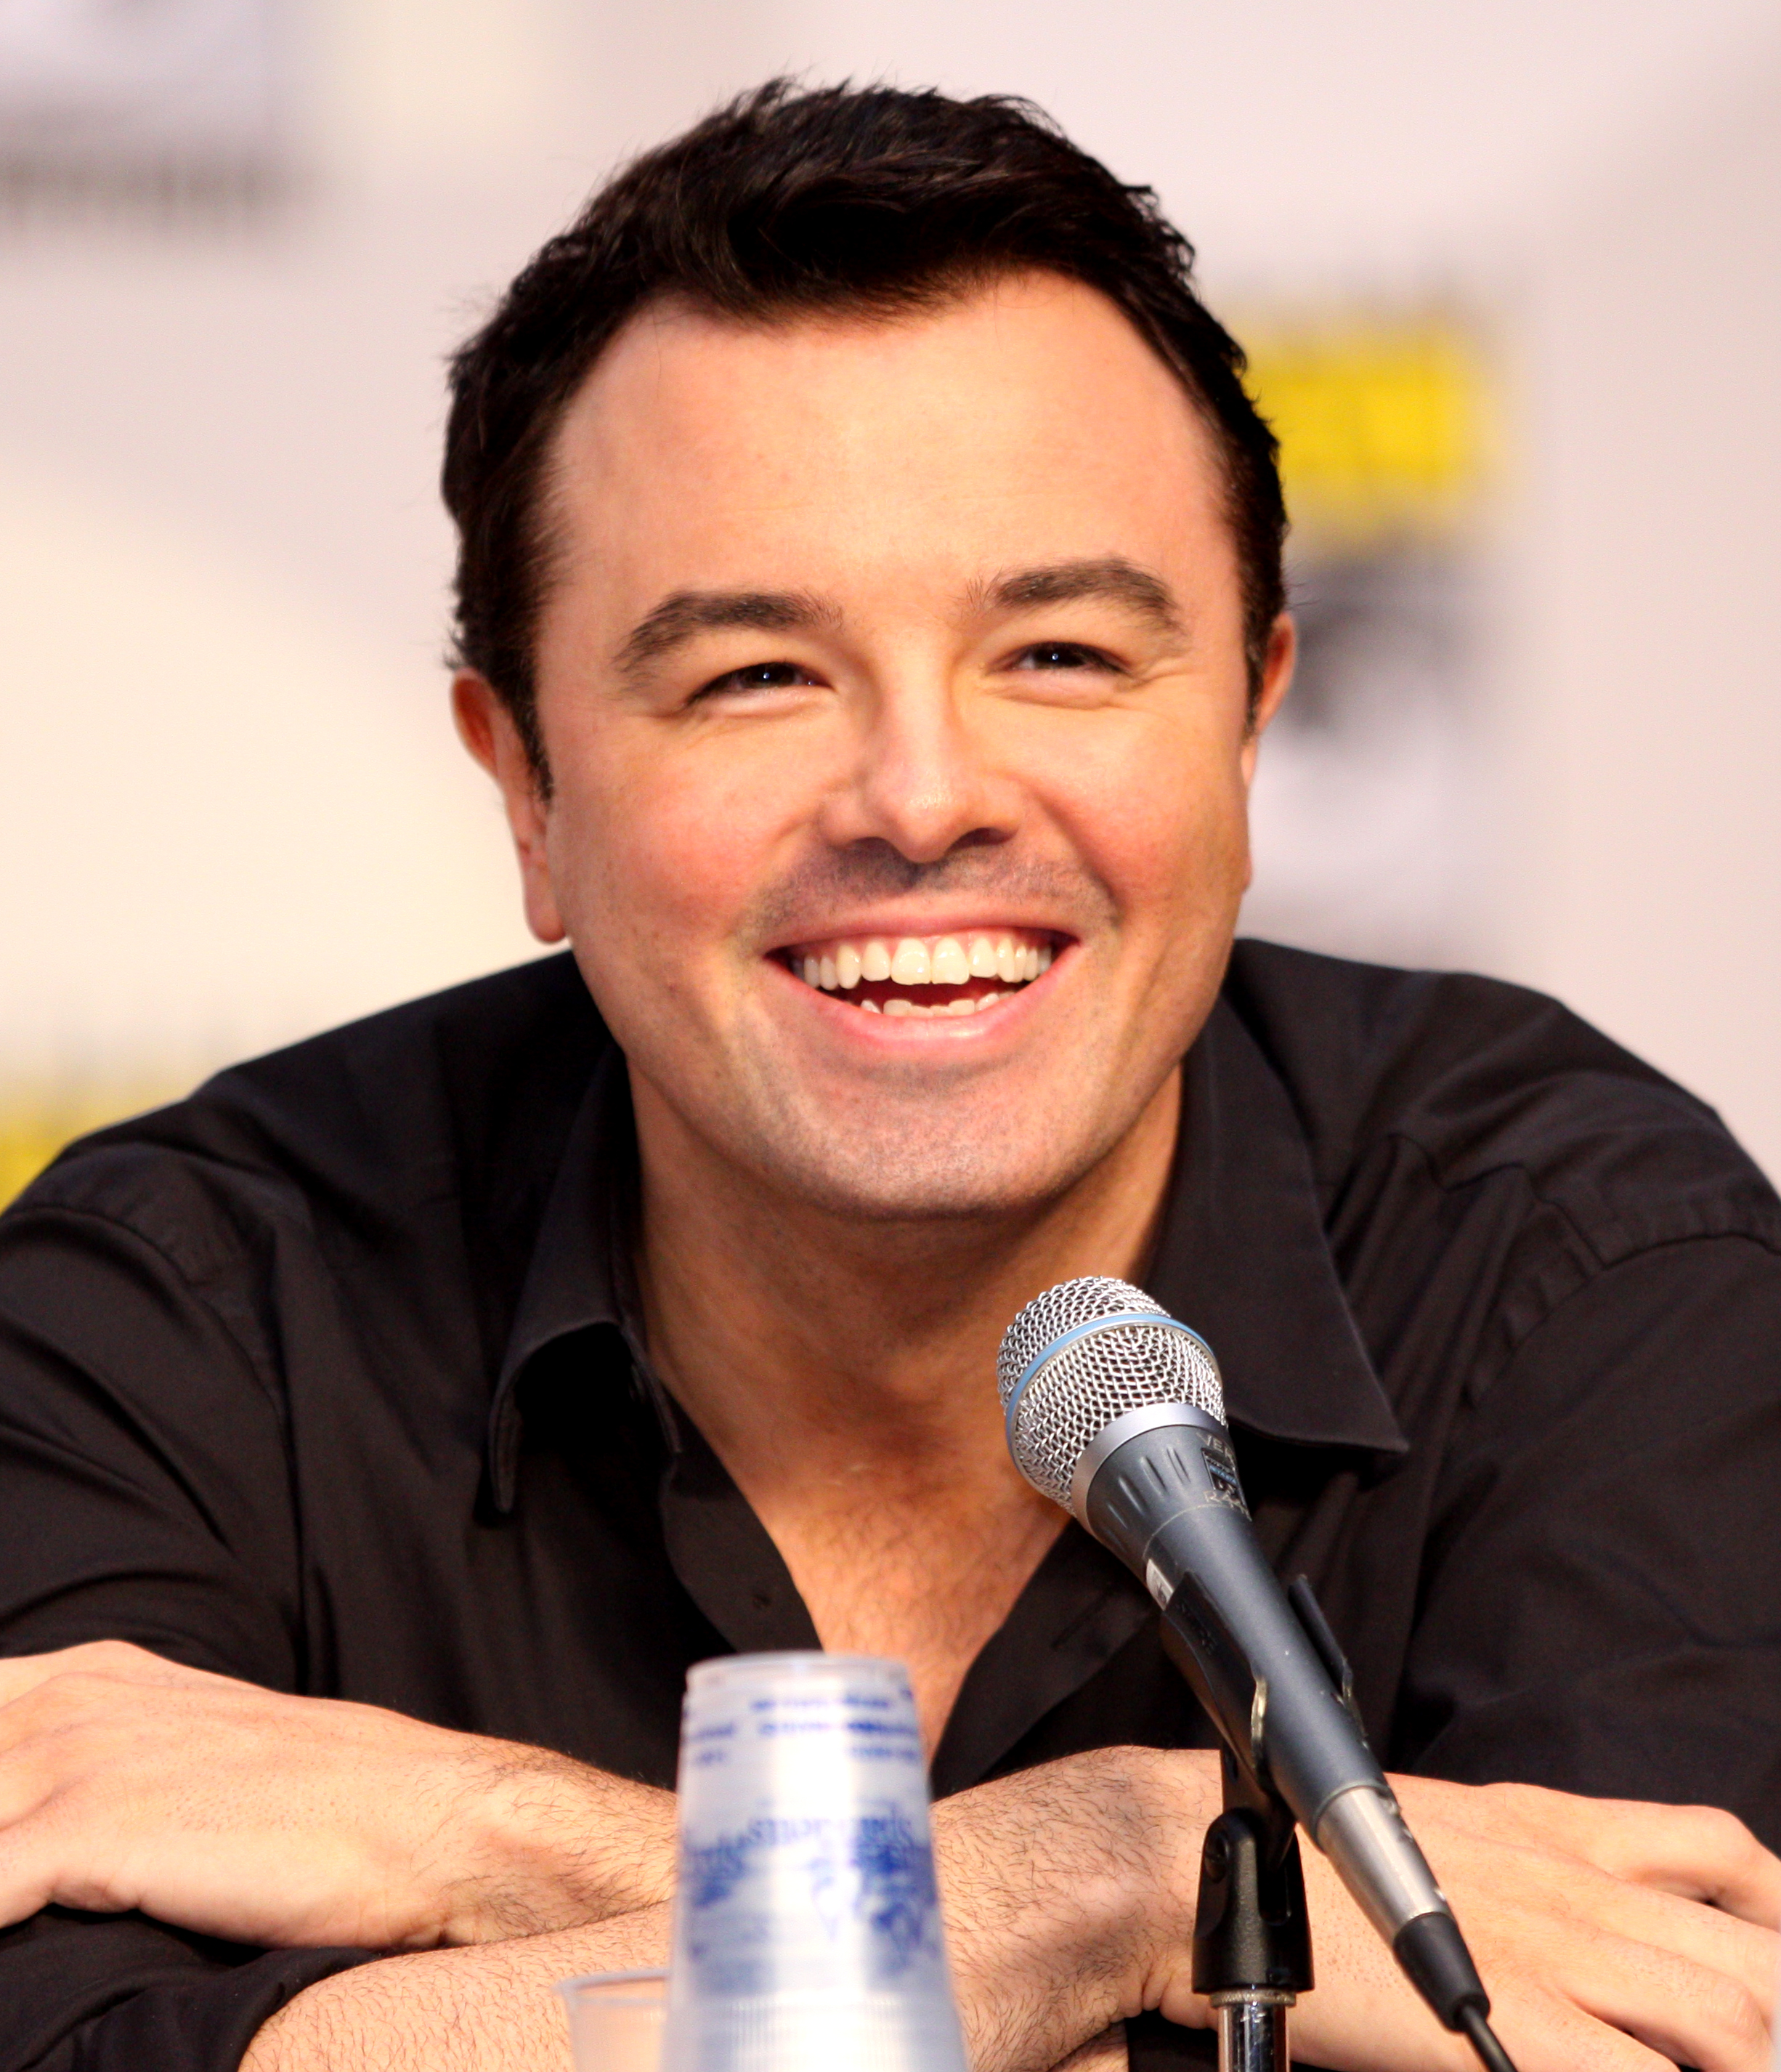
Smile
Notes:
A simple, yet potent way to make a human connection with others is to smile. When we are nervous we sometimes forget this powerful tool of audience engagement.

Slide 24
Notes:
Do you have any questions on giving lectures?

