Slide 1
Giving Feedback
Bringing Education & Service Together (BEST)

Slide 2
Learning Objectives
Administer constructive feedback
Explain the INSIGHT approach
Employ effective techniques

Slide 3
Learners in Difficulty
We’re all “in difficulty” sometimes….
First, diagnose your learner:
Temporary stressors
Knowledge or skill deficits
Attitudinal issues
Learning disabilities
Drug or alcohol problems

Slide 4
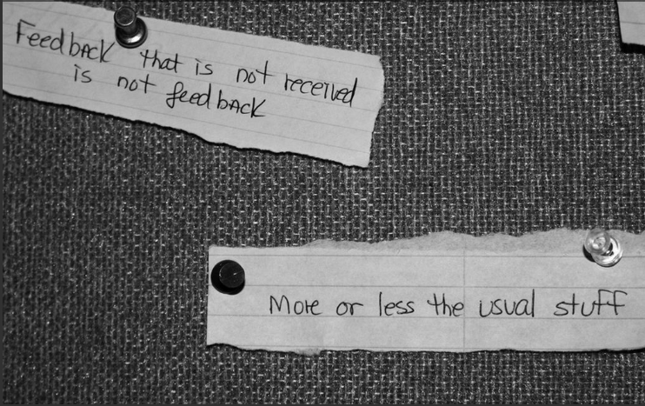
Why is feedback important?
cc: quinn.anya - https://www.flickr.com/photos/53326337@N00
Notes:
Why is feedback important?
Feedback is the lifeblood of learning.
There is a human tendency toward inaccurate self-assessment.
Reflective capacity is an essential characteristic for professional competence (Mann, Gordon, & MacLeod, 2009) then feedback from teachers and other learners is a critical step in the process,

Slide 5
It works!
Improves learning outcomes
Deepens learning
Encourages pursuit of understanding and application
Notes:
If done correctly, feedback:
Improves learning outcomes
Deepens learning
Encourages pursuit of understanding application

Slide 6
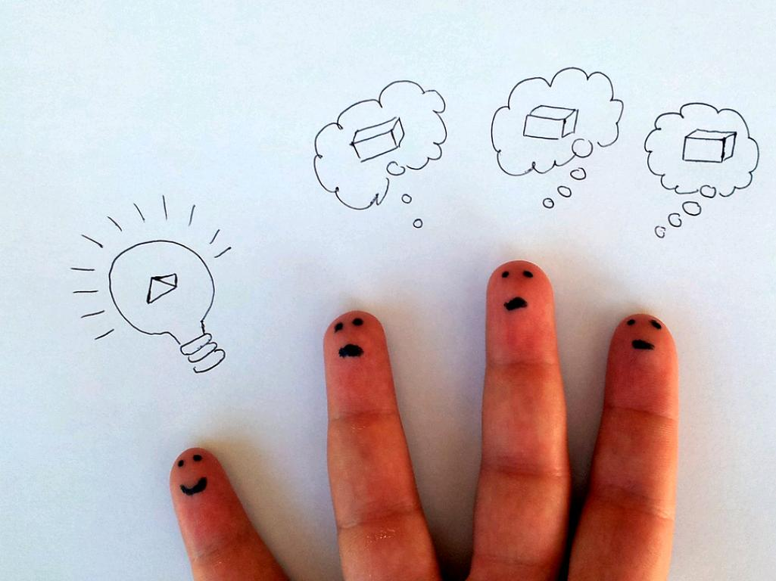
Feedback Models
Notes:
There are a few different models for effective feedback. We are only going to examine three:
Sandwich
One Minute Preceptor
Insight approach

Slide 7
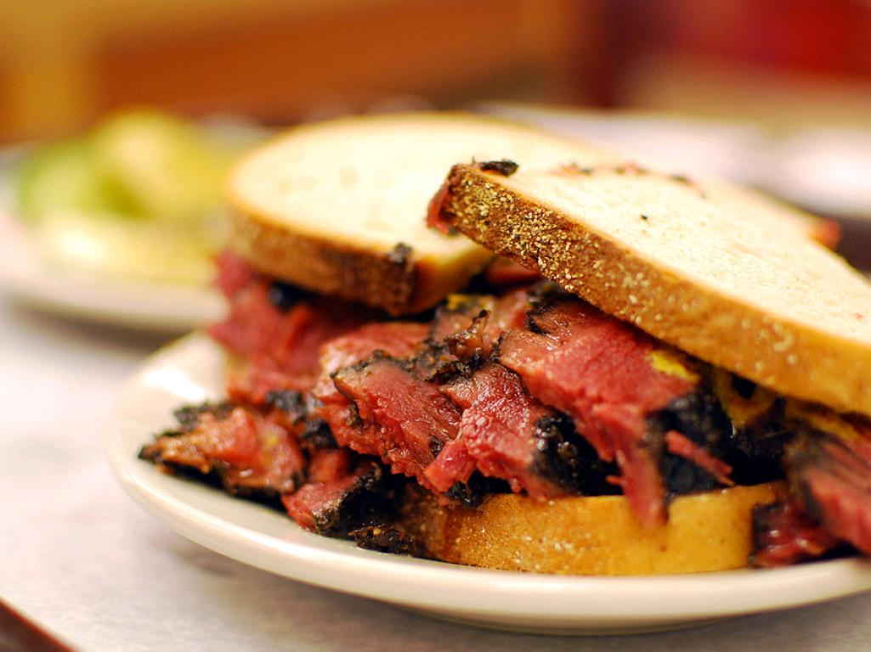
Sandwich
Notes:
Who is familiar with the sandwich method?
i.e., focus on the good news, sandwich in the bad news, and then end with more good news.
Challenges:
People don’t hear the first good news because they know the bad news is coming.
Most high performing people want to know what they can do to improve. They don’t necessarily want the blow softened.

Slide 8
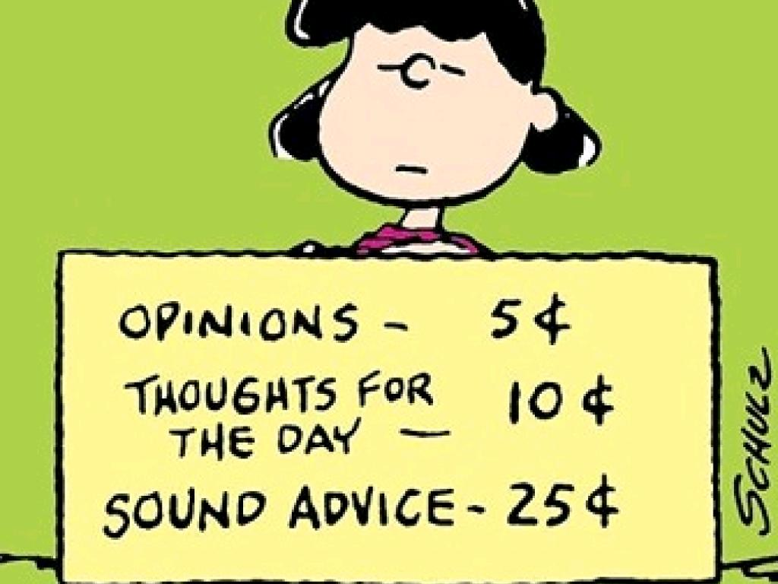
One-minute Preceptor
Notes:
Also known as the “Five Microskills of Clinical Teaching” the One Minute Preceptor is an evidence based practice that if done correctly saves time when giving feedback in a clinical environment.
This is the method we are recommending.

Slide 9
Why?
Teaches clinical reasoning/problem solving
Shows gaps in reasoning and knowledge
Identifies teachable moments
Creates a clear, consistent method
Notes:
Why are we recommending this method of clinical teaching?
Teaches clinical reasoning solving – It’s our nature as teachers to want to provide answers. Students learn more, however, when we ask them to seek their own answers. This process encourages the learner to think for themselves.
Shows gaps in reasoning and knowledge – It helps clearly show where there may be gaps in student understanding. This means you can focus your teaching specifically to areas where the need exists. You can avoid spending time explaining things the learner already understands and missing the opportunity to diagnose any problem areas.
Identifies teachable moments – Once you have seen the gaps in understanding, you can seize on those teachable moments. You will see the opportunity to drive home a specific point.
Creates a clear, consistent method – Since learners are learning at different sites and with different attending physicians, this method provides a point of consistency in the way they are taught and the way they are evaluated. So, regardless of which site a student ends up at, they are gaining and equivalent learning experience. (Not the same, mind you, but equivalent.)
The One Minute Preceptor has five steps. We will cover each one.

Slide 10
Step 1 - Get a commitment
Notes:
Commit to a differential diagnosis or assessment of problem.
Begin by asking the learner to commit to a decision. This allows the student to process the information and leads to deeper learning.
It asks the learner to commit to a diagnosis or treatment option, rather than just agreeing with the preceptor’s plan.
Avoid prompting the learner or suggesting any actions at this point.

Slide 11
Ask in a Non-threatening Way
What do you think is going on?
What do you want to do?
Guessing better for learning than no commitment (Lang 2016)
Notes:
Ask:
What do you think is going on here?
What do you want to do next?
What kind of investigations are indicated?
What would be your treatment plan?

Slide 12
Step 2 - Probe for Supporting Evidence
Notes:
Next, have the student explain their reasoning.
Explore the learner’s thought process. This gives you the opportunity to assess the learner’s clinical reasoning and to determine if there are any gaps in reasoning or misconceptions.
The purpose of this step is to identify any learning gaps so you can determine what they don’t know and what you can teach them.

Slide 13
Ask probing questions
What led you to that diagnosis?
Why did you choose that drug?
What factors did you consider in making that decision?
Identifies gaps in understanding
Need a positive learning climate
Notes:
Ask probing questions without judgment:
What lead you to that diagnosis?
Why did you choose that drug?
What factors did you consider in making that decision?
What made you choose that particular treatment?
Were there other options you considered and discarded?
What other alternatives did you consider?
How did you rule out other options?
If this patient was pregnant, would it alter your management?
This step identifies gaps in reasoning.
It needs to be a positive learning climate. It won’t work if the learner feels like they are being cross-examined.

Slide 14
Step 3 - Teach General Rules
If the patient has cellulitis, incision and drainage won’t help. That’s for an abscess, which you recognize by its fluctuance.
Choose a single, relevant teaching point
Check for learner understanding
Avoid anecdotes or personal preferences
Can skip if learner clearly knows principles
Notes:
After the student has had an opportunity to develop an assessment, backed up by verbalized reasoning, the preceptor may take a moment to do some targeted teaching about the specifics of the patient’s problem.
This teaching can be brief and focused on one specific teaching point derived from the case. (Association of Professors of Gynecology and Obstetrics)
Learning a way to approach the problem is more effective than learning isolated facts. The student learns to organize their knowledge and generalize it for other situations. Base the general principle you are teaching on any learning gaps you identified in the previous step.
This can be about symptoms, differential diagnosis, treatment, and more.
Choose a single, relevant teaching point.
Check the learner for understanding of the principle you are teaching.
Avoid anecdotes or personal preferences.
You might skip this step entirely if it is clear that the learner knows the principles well.

Slide 15
Step 4 - Reinforce what was done right
Notes:
Reinforcing good behaviors is an essential part of learning and ensures that students continue using them.
Focus on behaviors that were beneficial to the patient, colleague or clinic.
The best reinforcement is specific and focused.
You did a good job of _______________ because _________________.
Be specific and focus on patient interaction, oral presentation, reasoning processes, etc.

Slide 16
Reward competencies
It was good that you considered the patient’s age when you prescribed that drug, because other drug classes can cause more side effect in the elderly.
Notes:
Specifically, you did a good job of . . .
Here’s why that is important. . .
Avoid general praise like, “Great job!”

Slide 17
Step 5 - Correct Mistakes
Notes:
This step helps ensure that correct knowledge has been gained and creates a foundation for improvement.
While no one wants to be overly critical, avoiding confrontation and ignoring errors guarantees they will be repeated.
Focus on future behavior rather than dwelling on the error. Teach the student how to avoid making the same mistake next time. Begin with the student self-assessment as a launching off point.
Correct any mistakes the student made. Be specific.
Identify any knowledge or reasoning gaps. Focus on how the student might improve their practice the next time.
Point out areas for the student to work on in self-directed learning.
Provide suggestions on resources, if appropriate.

Slide 18
Be specific
You could be right that you won’t harm the brachial artery when you draw that blood gas. But if you use the radial artery, you won’t risk cutting off the arterial supply to the whole arm.
Have them self-critique first
Best done in private
Notes:
Specifically, you did a good job of . . .
Here’s why that is important. . .
Avoid general praise like, “Great job!”
Comments like “Your patient communication needs to be better” are not helpful since that could refer to the clarity of the student’s comments, their friendliness, their professional demeanor, etc. To respond to fuzzy performance, you might try: “How else could you have explained this to the patient?”

Slide 19
INSIGHT Approach
Inquiry
Needs
Specific
Interchange
Goals
Help
Timing

Slide 20
Inquiry
Notes:
How does the learner think things are going?
Listen to the learner’s needs in detail.
Listening attentively and thoroughly before commenting may be all you need to do, especially for minor/temporary problems.

Slide 21
Needs
Notes:
What does the learner feel s/he needs during this rotation?
Ask the learner to define own learning needs.
Learners accept feedback better when they feel the teacher has first understood their perspectives.

Slide 22
Specific
Notes:
Give your constructive feedback as specifically as you can.
Start with specific positive feedback.
• The more learner-centered the feedback, the better it will go.
Verify the learner’s understanding of the feedback you’ve given.

Slide 23
Interchange
Notes:
How can you best balance the learner’s needs with the team’s needs?
You may need to think creatively to find a mutually satisfying solution.

Slide 24
Goals
Notes:
State any new goals you’ve just reached, or review existing goals.
Verify that you both understand and agree on these goals.

Slide 25
Help
Notes:
Do any serious problems merit a learning consultation?
Chief resident
Attending physician
Learning specialist
Employee assistance program
Others

Slide 26
Timing
Notes:
Any final questions or comments?
When would you and the learner like to meet again to go over how things are going?

Slide 27
Tips
Notes:
Here are a few additional tips on giving effective feedback.

Slide 28
Timely
Notes:
Immediate – Feedback has a short shelf life because you can’t expect the student to remember every detail of their performance.
Try to give the feedback while the behavior is still fresh in the student’s mind.

Slide 29
Forward Focus
Notes:
Focus forward – Give small actionable items for next time. Ideally only one or two. That will end the discussion on a positive note and give the student something to focus on.
You don’t want a laundry list.
Keep it brief. 2-3 suggestions is enough for the student to work on in the short term.

Slide 30
Based on trust
Notes:
We tend to reject feedback if we don’t trust the messenger or feel like they have some kind of agenda of their own.
You must build credibility and rapport. The student must understand that the feedback is for their own good.

Slide 31
Notes:
Balances negative and positive.
If it’s too positive - students will gloss over mistakes and think they did everything right.
If it’s too negative – students will become discouraged and think they did nothing right.

Slide 32
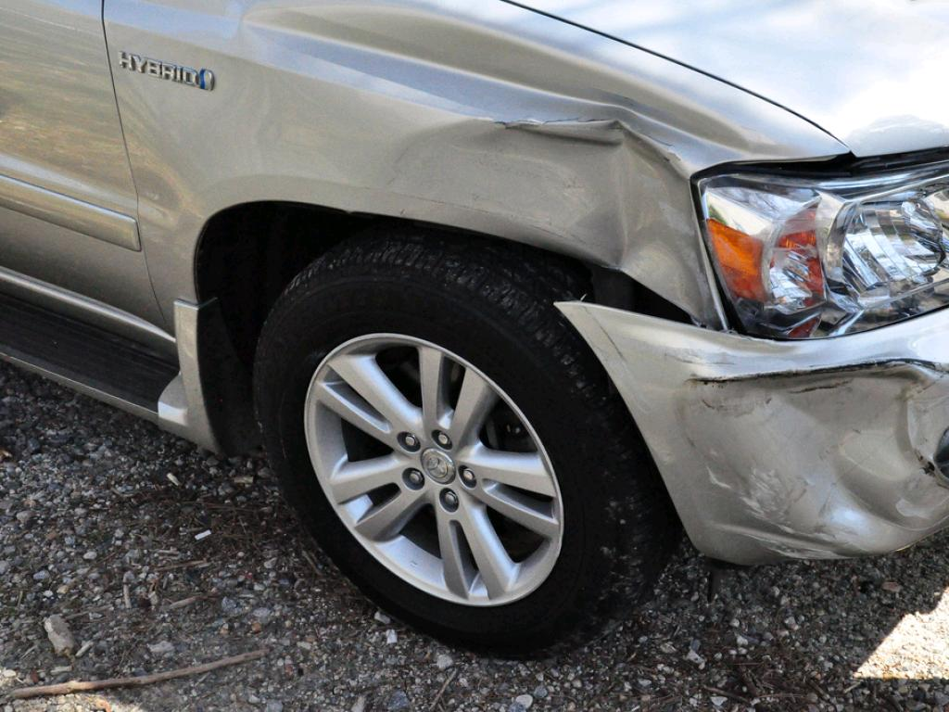
Explain Impact
Notes:
Explain the impact – Point out the direct results of the behavior. Using statements like “I noticed” or “It made me feel” are difficult to argue with. You avoid devolving into a debate about why I did it the way I did it. Example: “I noticed the patient was a little agitated.” Or “It made me feel like you wanted to get out as quickly as possible.”
Focus on how the behavior effected the patient or the practice.

Slide 33
Judgmental vs. Descriptive
Evaluative/Judgmental
Descriptive
The beginning was painful. You seemed to ignore her.
The beginning was wonderful! Great job!
At the beginning you were looking at notes, which prevented eye contact.
At the beginning you gave her your full attention and never lost eye contact. Your facial expression registered your interest in what she was saying.
Notes:
Avoid any language that makes a judgment. Use language that describes behavior, then explain why that may have been a good thing or a problem.

Slide 34
Deduction vs. Observation
Deduction
Observation
You don’t seem comfortable with older patients.
I noticed when you interviewed that older patient, you failed to make eye contact or use his name.
Notes:
Focus on observable behavior and avoid judgment calls.
Comments like, “You don’t seem comfortable with older patients” is a judgment call. You are deducing this from what you have observed. But you can’t know what caused the behavior you observed. You are just guessing.
Try: “I noticed that when you interviewed that older patient, you failed to make eye contact or use his name.”

Slide 35
Notes:
Do you have any questions on giving feedback?

