Slide 1
Introduction to Clinical Teaching
Bringing Education & Service Together (BEST)

Slide 2
Learning Objectives
Identify learning theory
Describe the teachable moment
Describe teaching style
Plan ways to improve teaching style

Slide 3
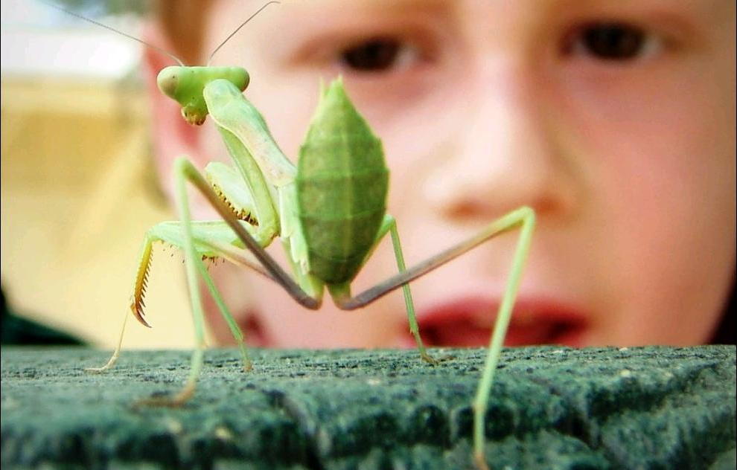
What is Learning?
cc: Wha'ppen - https://www.flickr.com/photos/9495733@N05
Notes:
What is learning?
Learning is not one thing.
It is how we perceive and understand the world around us.
It is about making meaning.
It might involve mastering certain methods or techniques.
It may be about recognition.
It may be about reasoning.
Remembering factual information

Slide 4
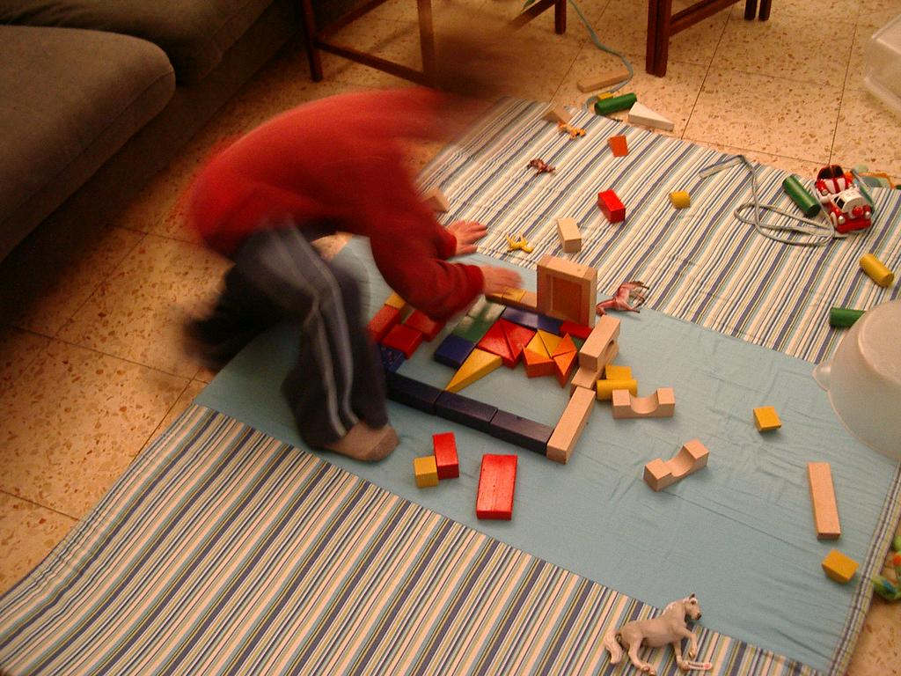
Constructivism
cc: ella novak - https://www.flickr.com/photos/82547169@N00
Notes:
Constructivism Theory. Developed by Jean Piaget – a pioneer in child development psychology.
According to this theory ---
People construct their own knowledge – like using building blocks to create a structure. We do this through experience and reflection.
When we encounter something new, we must reconcile it with our previous experiences. We might change our beliefs. We might discard the new info as irrelevant.
As such, we actively create our own knowledge and understanding of the world. To do this, we must ask questions, explore, and assess what we know.
Learning occurs due to continuous building and amending structures in the brain – known as schemata.
As new information enters and is understood, the schemata changes.
If schemata is unchanged – no learning has taken place.
Often see learning defined as a permanent change.
Take aways:
Learners require an opportunity to ask questions, explore and assess on their own.
There is no such thing as “temporarily” learning something – if it isn’t permanent you didn’t learn it.
Learners are not a blank slate. When we teach, we are always dealing with existing understandings, however rudimentary or incorrect.

Slide 5
Social Learning
cc: CGIAR Climate - https://www.flickr.com/photos/55227776@N04
Notes:
Social Learning Theory
Proposed by Lev Vygotsky and the work of Albert Bandura
The primary tenet of Social Learning theory is that social interaction plays a fundamental role in cognition.
A secondary part of the theory is that the potential for cognitive development depends upon the “zone of proximal development.” The range of skills that can be developed with peer collaboration exceeds what can be attained alone.
For example: When we learn our first language we do not begin by studying it. We learn by being in proximal range of others speaking that language.
Most human behavior is learned observationally through modeling. It involves 1) Attention; 2) Retention; 3) Motor reproduction; and 4) Motivation. Since it involves attention, memory and motivation this theory encompasses both cognitive and behavioral frameworks.
Where we see a lot of research using social learning theory is in the area of aggression. When children see someone else act out aggressively, they are more likely to do so themselves.
Another area built on social learning theory is TV commercials. If we see that drinking a particular brand of beer will make us more popular, we may vary our behavior and start drinking that brand. (or so the theory goes.)
Take aways:
Learning doesn’t take place in a vacuum.
Social and cultural context play a role in learning.

Slide 6
Socialization
Notes:
Learning defined as socialization into a new community of knowledge.

Slide 7
1970’s Behavioral Learning
Notes:
1970’s Behavioral Learning Theories

Slide 8
Change
Notes:
In behavioral learning, learning is defined as a permanent change in observable behavior.

Slide 9
Objectives
Notes:
The idea of behavioral learning objectives is introduced. Sometimes called learning outcomes today, the idea behind learning objectives was that we should be able to evaluate learning by assessing things we can observe. A behavioral learning objective might be something like:
By the end of this lesson students will be able to identify the three main causes of . . .
We can observe this through a simple multiple choice test. If the student can pick out the three main causes of whatever from that test, we can “observe” that they met the objective.

Slide 10
Student evaluations
of teaching
cc: AlicePopkorn - https://www.flickr.com/photos/14111752@N07
Notes:
Student ratings of teachers became popular.
The validity of these ratings continues to be a subject of great controversy within the education community. Some studies have upheld their validity, and other studies have seen evidence of gender and racial bias.
There is a strong correlation between student evaluations and grades, suggesting to some that students give higher evaluations to “easy” graders.
One recent study showed that evaluations did not correlate with student learning. Faculty who had students who did better on objective measures of learning, such as standard assessments and performance in subsequent math courses, did not receive higher evaluations.

Slide 11
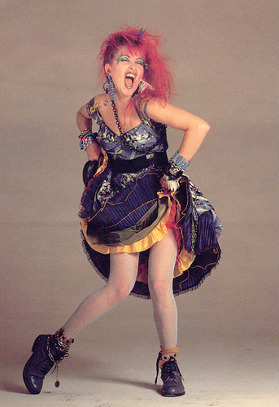
1980’s Cognitive Learning
Notes:
In the 1980’s cognitive learning theories were introduced

Slide 12
Encoding
Notes:
Teaching strategies focused on helping learners “encode” new knowledge within existing conceptual frameworks.

Slide 13
Learning culture
Notes:
Teachers seek to promote a “learning culture” among students.

Slide 14
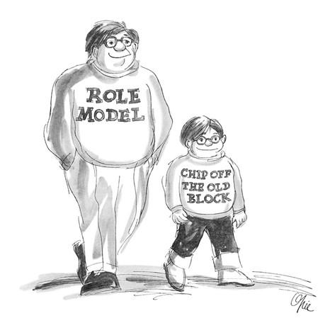
Role modeling
Notes:
Role modeling becomes particularly important in professional training.

Slide 15
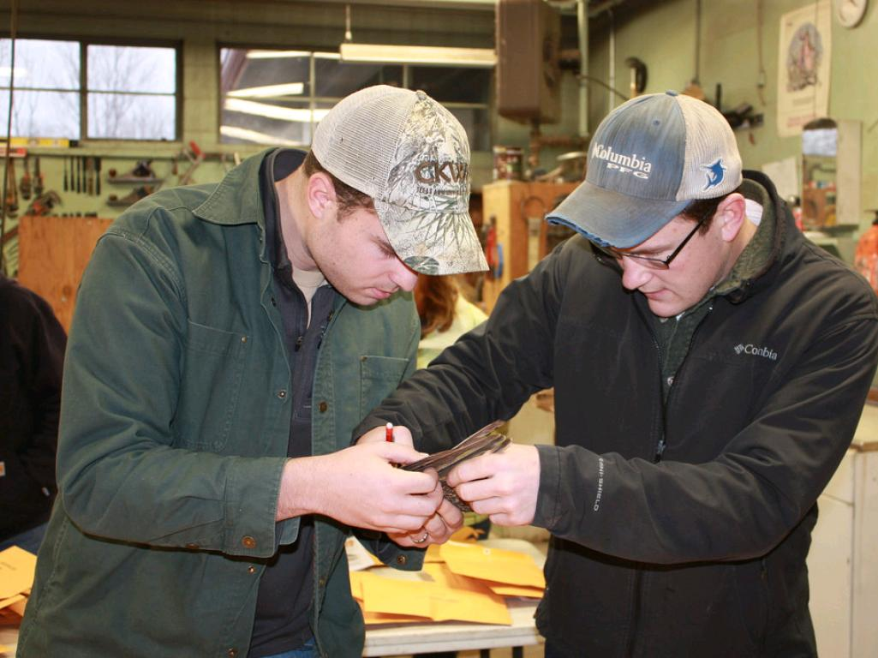
Adult Learning
cc: USFWS Pacific - https://www.flickr.com/photos/52133016@N08
Notes:
Adult Learning Theory aka andragogy
Proposed by Malcolm Knowles – an adult educator
5 Principles of adult learning theory:
As a person matures he or she becomes more self-directed
Adults have accumulated experiences that can be a rich resource for learning
Adults become ready to learn when they experience a need to know something
Adults tend to be less subject centered than children; they are increasingly problem centered
For adults the most potent motivators are internal
Take aways:
Adult learners bring a lifetime of experience to the learning environment.
Adult learners are motivated by an internal need to know and are self-directed.
What does that mean? As educators we have to show the relevance of what we are teaching. How will this information help me in attaining my goals? The challenge is sometimes the learners have very different goals that the teacher, right? Can anyone give me an example of this? One example might be I want you to learn everything I think is important about 18th century fashion, and you only want to learn enough so you can pass the class and move on to the topics you care more about.

Slide 16
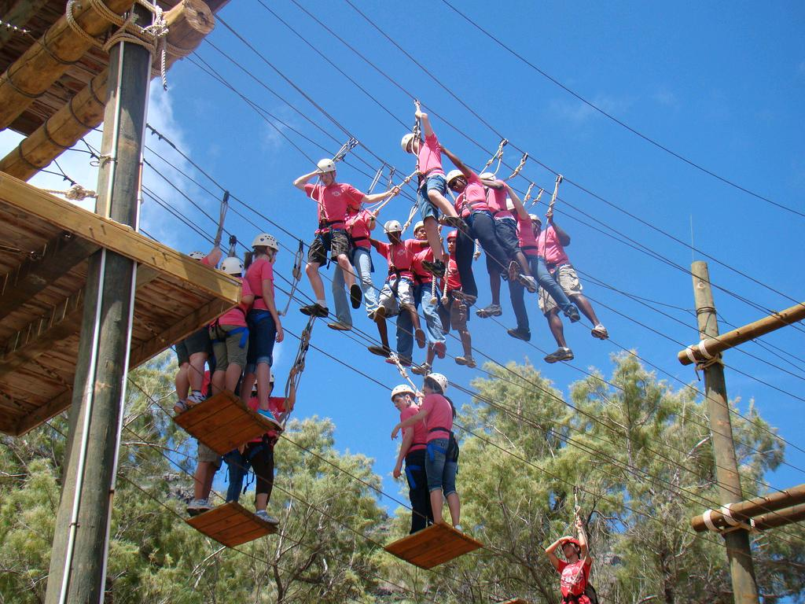
Experiential Learning
cc: familymwr - https://www.flickr.com/photos/36196762@N04
Notes:
Experiential learning – or hands-on learning – Proponents - David A. Kolb – Peter Senge – based on the work of John Dewey, Jean Piaget and others.
Examples: internships, job-shadowing, project based learning, etc.
I know you are all familiar with this because it is such a major part of this program. Can you give me some examples of how it is used here in the SOM?
Reflection is a key part of experiential learning as it turns experience into learning.
Reflection on practice is central to learning and development of knowledge.
Kolb states that in order to gain knowledge from experience, the leaner needs four abilities:
The learner must be willing to be actively involved in the experience;
The learner must be able to reflect on the experience;
The learner must possess and use analytical skills to conceptualize the experience; and
The learner must possess decision making and problem solving skills in order to use the new ideas gained from the experience.
Reflection is supported by feedback.
Good example is the SP.
After spending time interviewing the SP, a learner is given time to reflect on his or her performance before any feedback is given with questions such as:
What communication skills did you use effectively?
What communication skills did you use less effectively?
Take aways:
Experience without reflection does not result in learning.
The learner has to be a willing participant in the experience for it to be fully effective. The problem is we sometimes use experiential learning where the learners don’t actually want to participate. Can you give me an example of a time when you didn’t want to participate in an experiential learning opportunity? I can share one of mine. I selected this picture intentionally because I have had to do these “ropes” courses a few times as team building activities. The most recent was when I was at UCLA working on my doctorate. What did I learn from the experience? I really hate these ropes courses and I don’t like enforced “trust” exercises. For me, trust takes time and experience with the person and no amount of fake exercises is going to make me trust someone. Call me a cynical old lady if you want, but that’s true. I doubt those were the lessons the ropes course people were trying to teach!

Slide 17
Surface vs. Deep
cc: AlicePopkorn - https://www.flickr.com/photos/14111752@N07
Notes:
Surface vs. deep learning
Surface learning = students simply want to complete the task or memorize information.
Rote learning is a typical surface approach.
Students use this style of learning when they see the task as externally imposed.
Facts are learned without any kind of meaningful framework or ability to integrate with existing knowledge.
Vs.
Deep learning = student has intent to understand and seek meaning.
Learner will critically evaluate incoming information.
Key is intentionality.
Evidence shows that educators who take a student-centered approach (rather than a content-centered) to teaching and learning encourage students towards a deep learning approach.

Slide 18
Combine
Notes:
Resident teachers and medical faculty can combine and expand learning theories from past decades to create new approaches to teaching and learning.

