Slide 1
Orienting Learners
Bringing Education & Service Together (BEST)

Slide 2
Learning Objectives
Orient medical student/intern
Clarify goals for a session
Explain how learner balances service vs. learning goals

Slide 3
ORIENT Approach
Orientation
Responsibilities
Interchange
Education
Needs
Timing

Slide 4
Orientation
Notes:
Clarify mutual goals for this orientation session:
What are the learner’s expectations today?
Discuss mutual goals and expectations for the rotation.
Start with the learner and explore the learner’s concerns and interests in detail.
What does she or he want from this rotation?
What are his or her goals for the rotation?

Slide 5
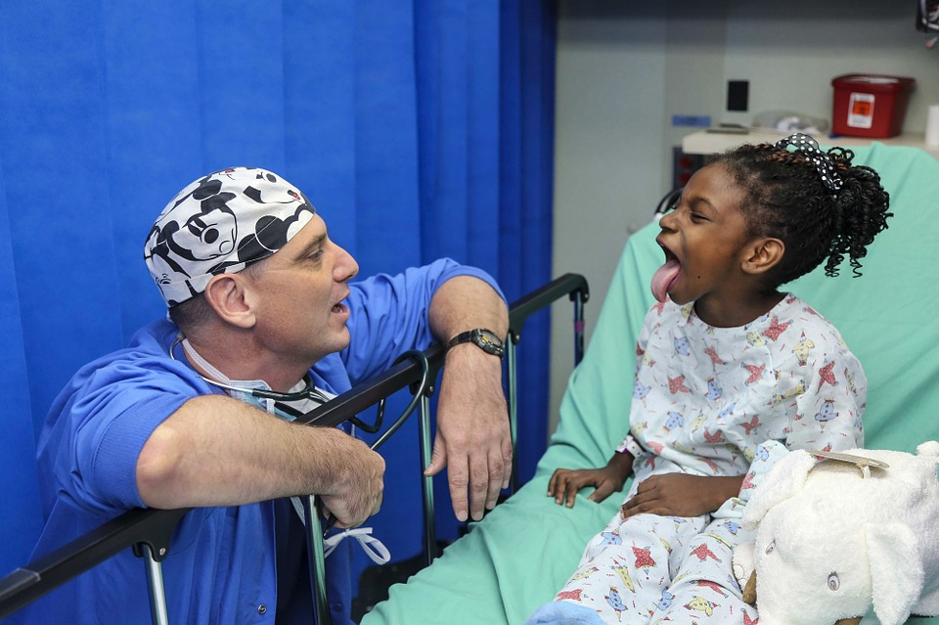
Responsibilities
Notes:
Explain learner’s role in patient care and other teamwork:
Format for supervision and teaching
Expectations regarding charting
Explain learner’s role in patient care and other teamwork:
Where and when learner will receive feedback
Call arrangements
Anything else s/he should know about your particular institution

Slide 6
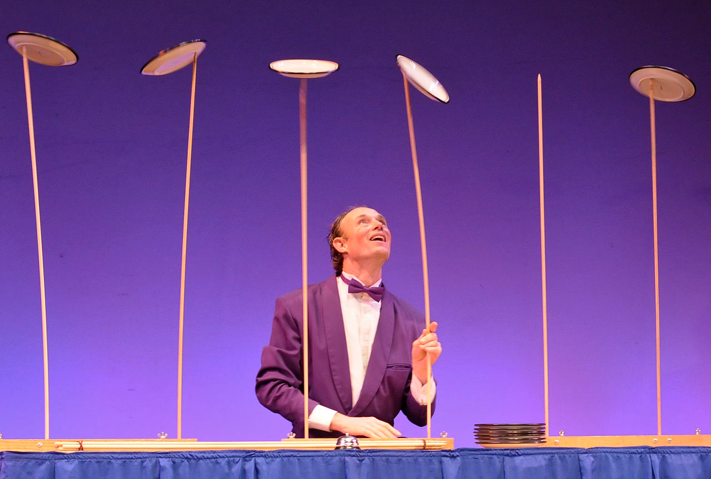
Interchange
Image by Henrikbothe - Own work, CC BY-SA 4.0, https://commons.wikimedia.org/w/index.php?curid=45415174
Notes:
How can the learner best balance service vs. learning goals during the rotation?

Slide 7
Education
Notes:
Model self-directed learning:
Ask learner to define his or her own learning goals and how she or he can best achieve them.
Offer suggestions for reading and learning during the rotation (books, articles, online resources, consultants).

Slide 8
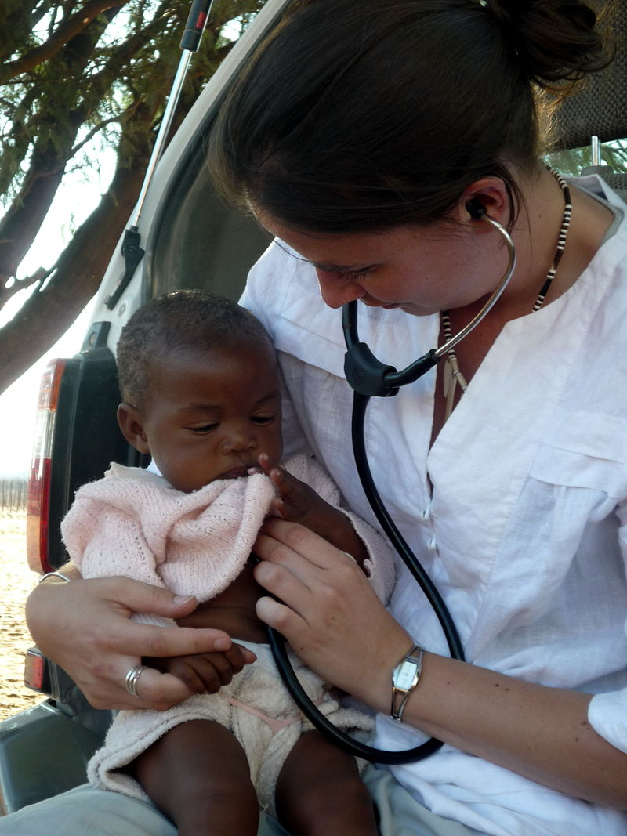
Needs
Photo by Cwormley at English Wikipedia, CC BY-SA 3.0, https://commons.wikimedia.org/w/index.php?curid=32925306
Notes:
What questions does the learner have?
Is there anything else going on that you might help with (e.g., any special needs or concerns)?

Slide 9
Timing
Notes:
Any final questions or comments?
When would learner prefer to meet again to follow up on mutual goals for the rotation?

